Slide 1
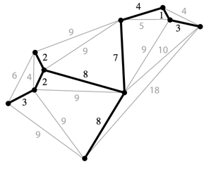
Spanning Trees
Given an undirected graph, a spanning tree T is a subgraph of G, where T:
Is connected.
Is acyclic.
Includes all of the vertices.
Example:
Spanning tree is the black edges and vertices.
These two properties make it a tree.
This makes it spanning.
A minimum spanning tree is a spanning tree of minimum total weight.
Example: Directly connecting buildings by power lines.

Slide 2
Spanning Trees

Slide 3
How Many are Spanning Trees? http://yellkey.com/now

Slide 4
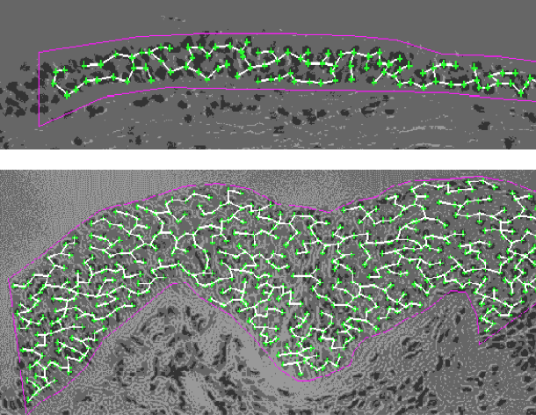
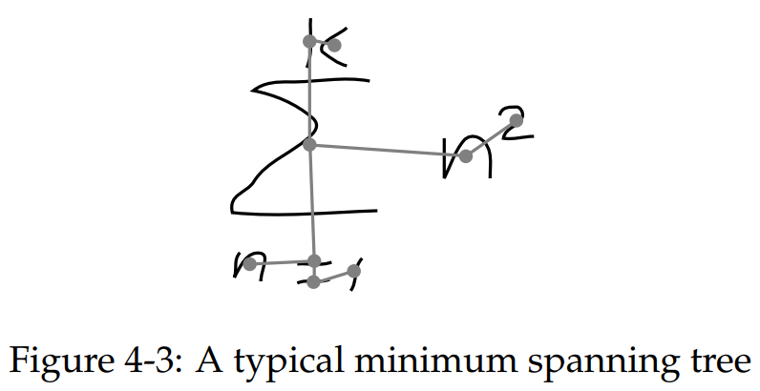
MST Applications
Old school handwriting recognition (left (link))
Medical imaging (e.g. arrangement of nuclei in cancer cells (right))
For more, see: http://www.ics.uci.edu/~eppstein/gina/mst.html

Slide 5
MST
Find the MST for the graph.
B
C
2
2
s
2
A
3
D

Slide 6
MST
Find the MST for the graph.
B
C
2
2
s
2
A
3
D

Slide 7
MST vs. SPT, http://yellkey.com/sit
Is the MST for this graph also a shortest paths tree? If so, using which node as the starting node for this SPT?
A
B
C
D
No SPT is an MST.
B
C
2
2
s
2
A
3
D

Slide 8
MST vs. SPT
Is the MST for this graph also a shortest paths tree? If so, using which node as the starting node for this SPT?
A
B
C
D
No SPT is an MST.
B
C
2
2
2
A
3
D
s = D
Doesn’t work for s = D!

Slide 9
MST vs. SPT, http://yellkey.com/approach
Is the MST for this graph also a shortest paths tree? If so, using which node as the starting node for this SPT?
A
B
C
D
No SPT is an MST.
SPT from A
B
C
2
2
s
2
A
3
D
s
SPT from B,
MST
B
C
2
2
2
A
3
D
s
SPT from C
SPT from D
B
C
2
2
s
s
2
A
3
D

Slide 10
MST vs. SPT, http://yellkey.com/approach
A shortest paths tree depends on the start vertex:
Because it tells you how to get from a source to EVERYTHING.
There is no source for a MST.
Nonetheless, the MST sometimes happens to be an SPT for a specific vertex.

Slide 11
Spanning Tree, http://yellkey.com/both
Give a valid MST for the graph below.
Hard B level question: Is there a node whose SPT is also the MST?
Yes
No
1
1
1
1
1
1
2
2
0
0
1
2
2
1
1
1
1
1
Notes:
SPLIT INTO TWO PROBLEMS: What is the MST? And is there a node for which it is the SPT?

Slide 12
Spanning Tree
Give a valid MST for the graph below.
Is there a node whose SPT is also the MST? [see next slide]
1
1
1
1
1
1
2
2
0
0
1
2
2
1
1
1
1
1

Slide 13
Spanning Tree
Give a valid MST for the graph below.
Is there a node whose SPT is also the MST?
No! Minimum spanning tree must include only 2 of the 2 weight edges, but the SPT always includes at least 3 of the 2 weight edges.
1
1
1
1
1
1
2
2
0
0
1
2
2
1
1
1
1
1
Example SPT from bottom left vertex:
1
1
1
1
1
1
2
2
0
0
1
2
2
1
1
1
1
1

Slide 14
Prim’s Algorithm

Slide 15
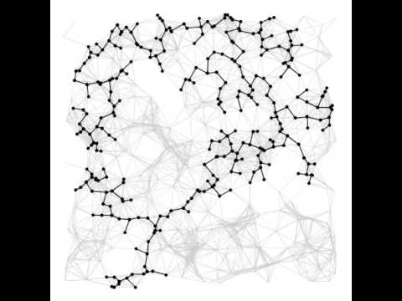
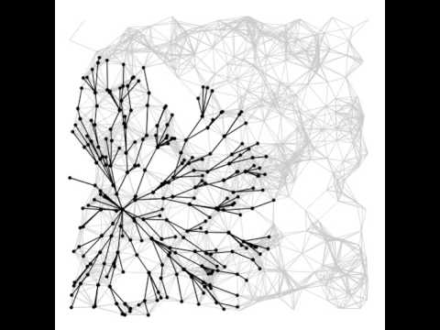
Prim’s vs. Dijkstra’s (visual)
Prim’s Algorithm
Dijkstra’s Algorithm
Demos courtesy of Kevin Wayne, Princeton University

Slide 16
Prim’s vs. Dijkstra’s
Prim’s and Dijkstra’s algorithms are exactly the same, except Dijkstra’s considers “distance from the source”, and Prim’s considers “distance from the tree.”
Visit order:
Dijkstra’s algorithm visits vertices in order of distance from the source.
Prim’s algorithm visits vertices in order of distance from the MST under construction.
Relaxation:
Relaxation in Dijkstra’s considers an edge better based on distance to source.
Relaxation in Prim’s considers an edge better based on distance to tree.

Slide 17
Prim’s Implementation (Pseudocode, 1/2)
public class PrimMST {
public PrimMST(EdgeWeightedGraph G) {
edgeTo = new Edge[G.V()];
distTo = new double[G.V()];
marked = new boolean[G.V()];
fringe = new SpecialPQ<Double>(G.V());
distTo[s] = 0.0;
setDistancesToInfinityExceptS(s);
insertAllVertices(fringe);
/* Get vertices in order of distance from tree. */
while (!fringe.isEmpty()) {
int v = fringe.delMin();
scan(G, v);
}
}
...
Fringe is ordered by distTo tree. Must be a specialPQ like Dijkstra’s.
Get vertex closest to tree that is unvisited.
Scan means to consider all of a vertices outgoing edges.

Slide 18
Prim’s Implementation (Pseudocode, 2/2)
while (!fringe.isEmpty()) {
int v = fringe.delMin();
scan(G, v);
}
Important invariant, fringe must be ordered by current best known distance from tree.
private void scan(EdgeWeightedGraph G, int v) {
marked[v] = true;
for (Edge e : G.adj(v)) {
int w = e.other(v);
if (marked[w]) { continue; }
if (e.weight() < distTo[w]) {
distTo[w] = e.weight();
edgeTo[w] = e;
pq.decreasePriority(w, distTo[w]);
}
}
}
Vertex is closest, so add to MST.
Already in MST, so go to next edge.
Better path to a particular vertex found, so update current best known for that vertex.

Slide 19
Prim’s Runtime
What is the runtime of Prim’s algorithm?
Assume all PQ operations take O(log(V)) time.
Give your answer in Big O notation.
while (!fringe.isEmpty()) {
int v = fringe.delMin();
scan(G, v);
}
private void scan(EdgeWeightedGraph G, int v) {
marked[v] = true;
for (Edge e : G.adj(v)) {
int w = e.other(v);
if (marked[w]) { continue; }
if (e.weight() < distTo[w]) {
distTo[w] = e.weight();
edgeTo[w] = e;
pq.decreasePriority(w, distTo[w]);
}
}
}

Slide 20
Prim’s Algorithm Runtime
Priority Queue operation count, assuming binary heap based PQ:
Insertion: V, each costing O(log V) time.
Delete-min: V, each costing O(log V) time.
Decrease priority: O(E), each costing O(log V) time.
Operation not discussed in lecture, but it was in lab 10.
Overall runtime: O(V*log(V) + V*log(V) + E*logV).
Assuming E > V, this is just O(E log V).
 | # Operations | Cost per operation | Total cost
PQ add | V | O(log V) | O(V log V)
PQ delMin | V | O(log V) | O(V log V)
PQ decreasePriority | O(E) | O(log V) | O(E log V)

Slide 21
Kruskal’s Algorithm

Slide 22
Kruskal’s Implementation (Pseudocode)
What is the runtime of Kruskal’s algorithm?
Assume all PQ operations take O(log(V)) time.
Assume all WQU operations take O(log* V) time.
Give your answer in Big O notation.
public class KruskalMST {
private List<Edge> mst = new ArrayList<Edge>();
public KruskalMST(EdgeWeightedGraph G) {
MinPQ<Edge> pq = new MinPQ<Edge>();
for (Edge e : G.edges()) {
pq.insert(e);
}
WeightedQuickUnionPC uf =
new WeightedQuickUnionPC(G.V());
while (!pq.isEmpty() && mst.size() < G.V() - 1) {
Edge e = pq.delMin();
int v = e.from();
int w = e.to();
if (!uf.connected(v, w)) {
uf.union(v, w);
mst.add(e);
} } } }

Slide 23
Kruskal’s Runtime
Fun fact: In HeapSort lecture, we discuss how do this step in O(E) time using “bottom-up heapification”.
Kruskal’s algorithm on previous slide is O(E log E).
Note: If we use a pre-sorted list of edges (instead of a PQ), then we can simply iterate through the list in O(E) time, so overall runtime is O(E + V log*V + E log* V) = O(E log*V).
Operation | Number of Times | Time per Operation | Total Time
Insert | E | O(log E) | O(E log E)
Delete minimum | O(E) | O(log E) | O(E log E)
union | O(V) | O(log* V) | O(V log* V)
isConnected | O(E) | O(log* V) | O(E log*V)

Slide 24
Shortest Paths and MST Algorithms Summary
Problem | Algorithm | Runtime (if E > V) | Notes
Shortest Paths | Dijkstra’s | O(E log V) | Fails for negative weight edges.
MST | Prim’s | O(E log V) | Analogous to Dijkstra’s.
MST | Kruskal’s | O(E log E) | Uses WQUPC.
MST | Kruskal’s with pre-sorted edges | O(E log* V) | Uses WQUPC.
Question: Can we do better than O(E log* V)?

Slide 25
170 Spoiler: State of the Art Compare-Based MST Algorithms
year | worst case | discovered by
1975 | E log log V | Yao
1984 | E log* V | Fredman-Tarjan
1986 | E log (log* V) | Gabow-Galil-Spencer-Tarjan
1997 | E α(V) log α(V) | Chazelle
2000 | E α(V) | Chazelle
2002 | optimal (link) | Pettie-Ramachandran
??? | E ??? | ???
(Slide Courtesy of Kevin Wayne, Princeton University)

Slide 26
Citations
Tree fire: http://www.miamidade.gov/fire/library/hotlines/2011-december_files/tree-fire.jpg
Bicycle routes in Seattle: https://www.flickr.com/photos/ewedistrict/21980840
Cancer MST: http://www.bccrc.ca/ci/ta01_archlevel.html

